Slide 1

Strategic Portfolio Construction - using Python & Market Data
A data-driven approach to optimal asset allocation and modern Portfolio theory
Jonas Bahmann
Levente Mihalyi
Eliseo Carrasco Krämer

Slide 2
Objective & Methodology Outline
In this project, we will construct a strategic investment portfolio using historical market data. The portfolio is built from a selection of diversified asset classes to balance risk and return across different economic sectors and geographies.
Methodology
1. Data import & first impression
2. Statistical return diagnostics (Jarque-Bera)
3. Investment opportunity set & efficient frontier
4. Tangency vs. Optimal complete portfolio
5. Risk decomposition via OLS
6. Out-of-sample performance evaluation

Slide 3
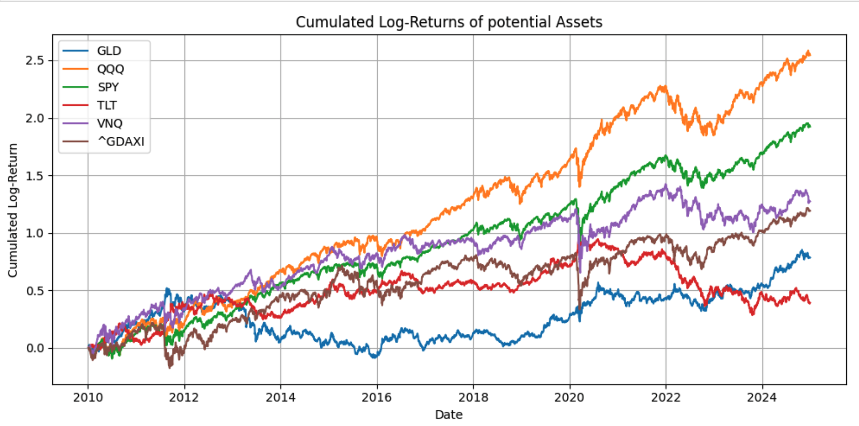
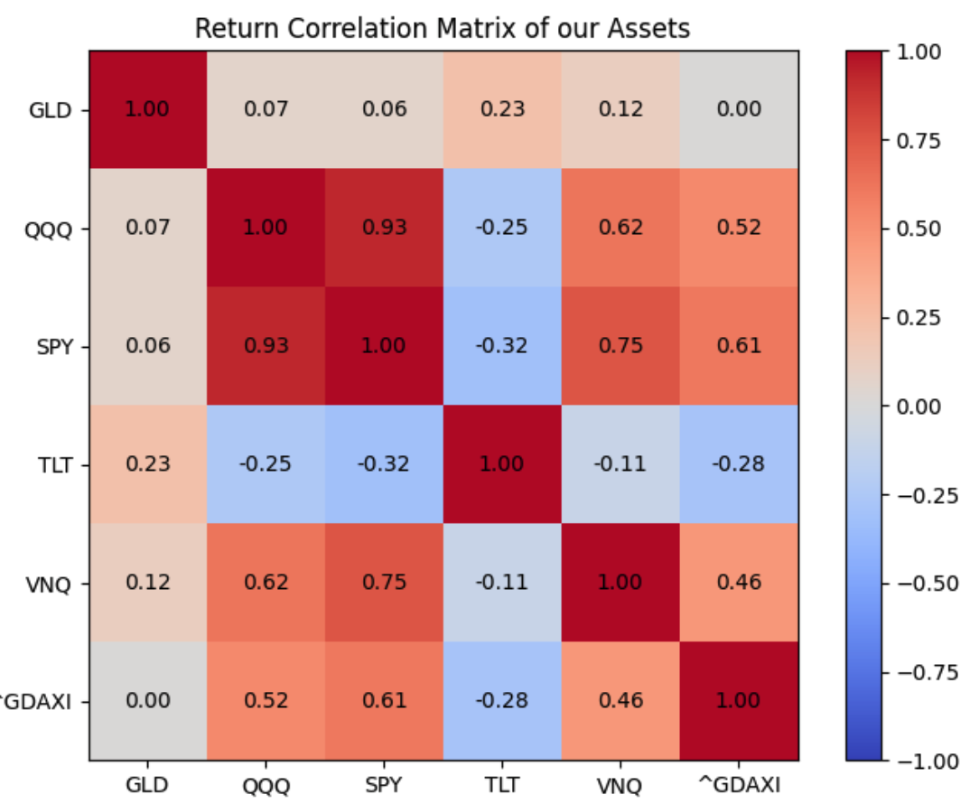
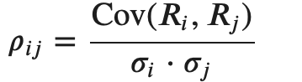
1. Data Selection
Data source: Yahoo Fincance
Assets: Nasdaq, S&P, Gold, REITs, DAX, Bonds
Different Asset classes → Diversification
Visualize cumulated log-returns of our assets
Correlation
S&P and Nasdaq are highly correlated
Gold ist almost neutral
US-Bonds and Stocks are negatively correlated
→ hedging and minimizing volatility

Slide 4
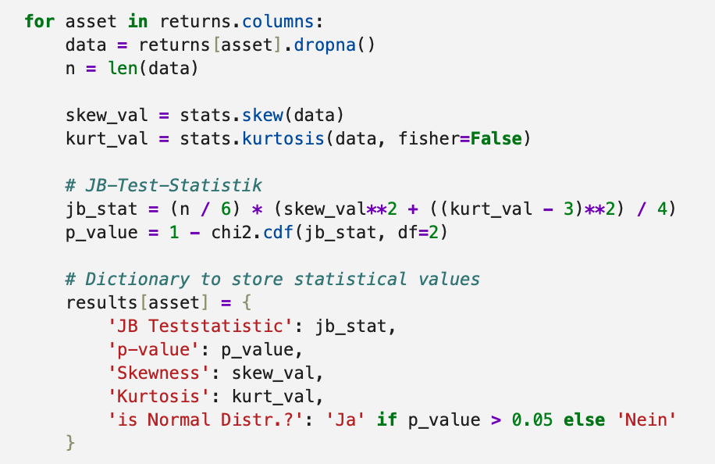
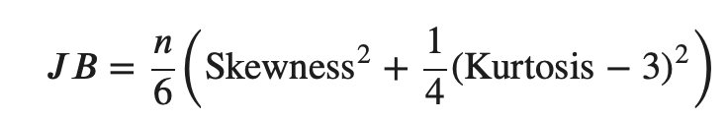
2.1 Jarque-Bera Test Are our returns normally distributed?
CAPM assumes normality
Kurtosis: tells us how heavy the tails are (black swans)
Skewness: tells us if the distribution is loopsided
Test- statistic:

Slide 5
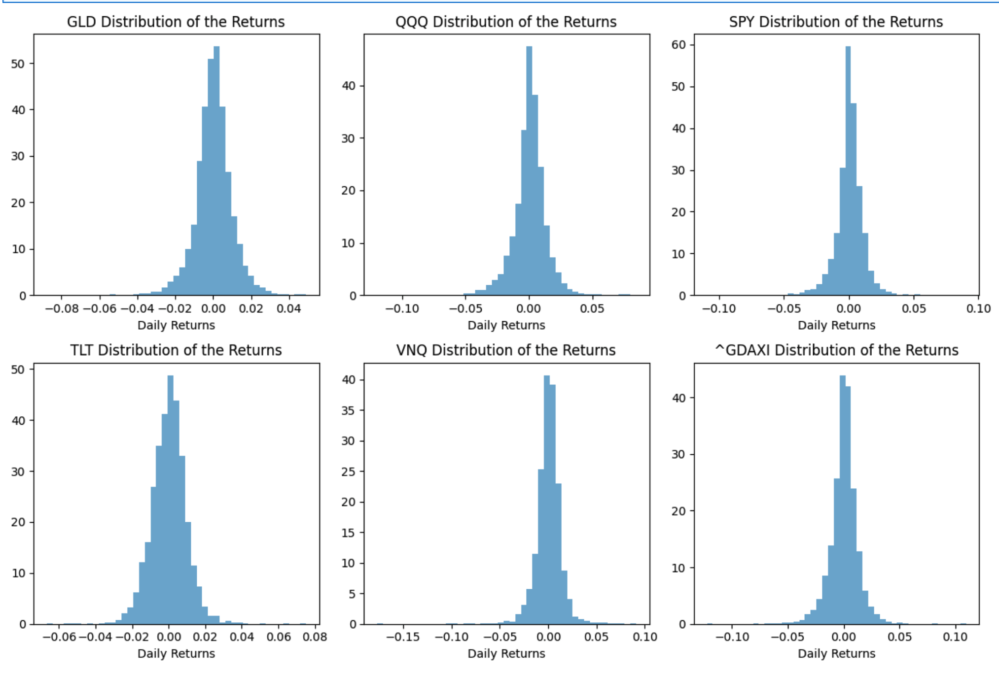
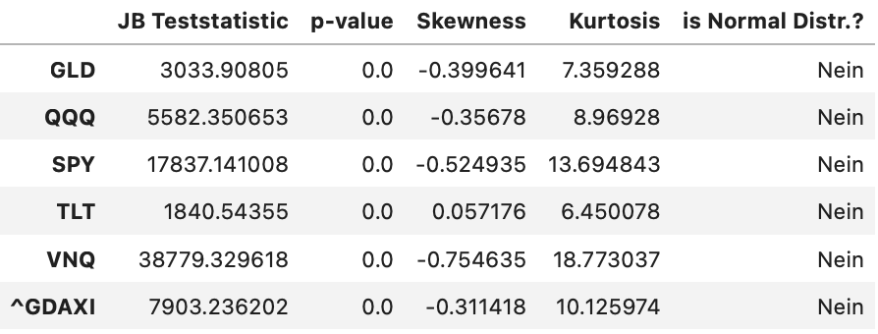
2.2 Jarque-Bera - results
In theory: returns follow a normal distribution
In reality: our returns are not Gaussian (p<0.05)
Fat Tails (extrem events more likeli)
Black swans: Covid shock, Financial Bubble
Returns are skewed (e. g. markets go asymetrically)
→ We still can use CAPM – but we consider limitations in our model when interpreting

Slide 6
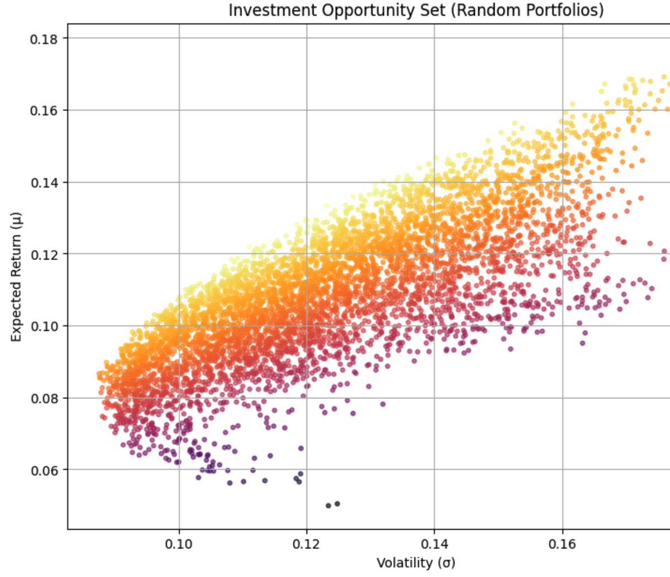
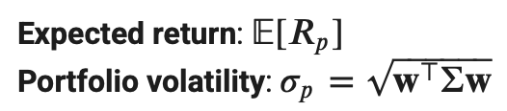
3.1 Investment opportunity set & efficient frontier
Possible Portfolios formed by combination of our assets
Efficient Froniter
Portfolios that offer max. return to a given level of risk
Markovitz Mean-Variance Optimization| Trade-off between:
Next step: Tangency portfolio
→linear combination of risk-free-asset and portfolio
→maximize the slope of the line (Sharpe Ratio)

Slide 7
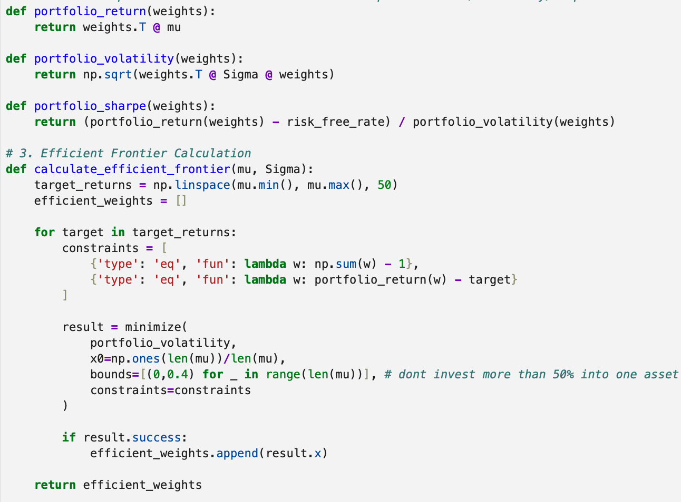
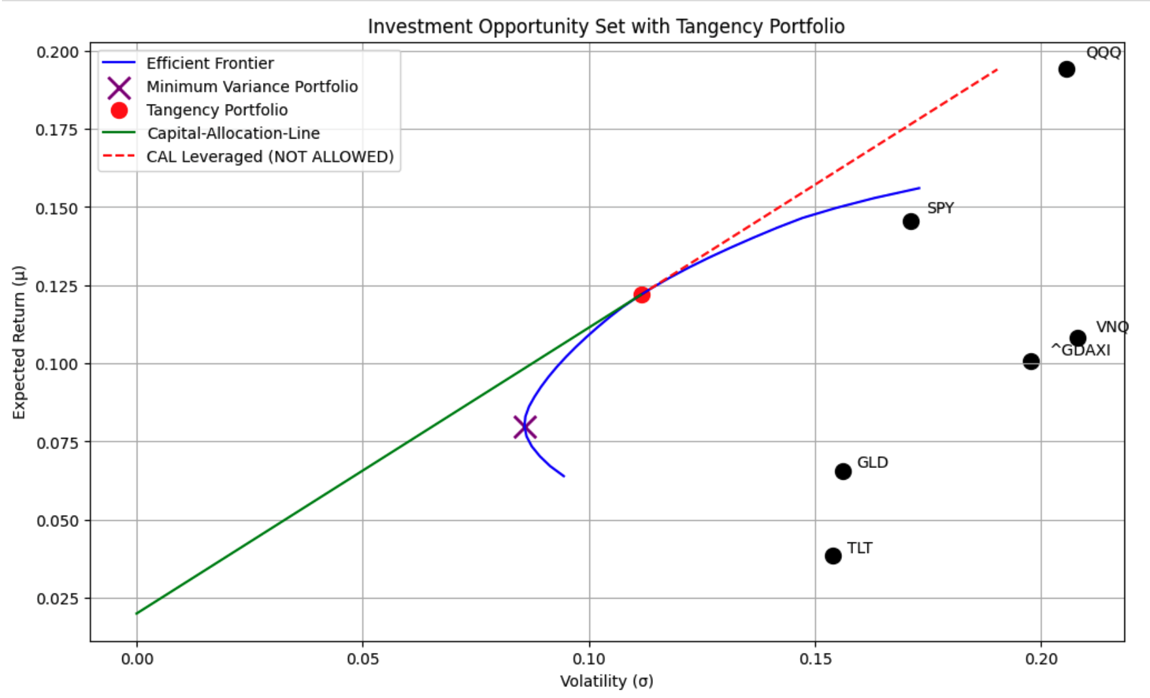
3.2 Efficient Frontier - Python

Slide 8
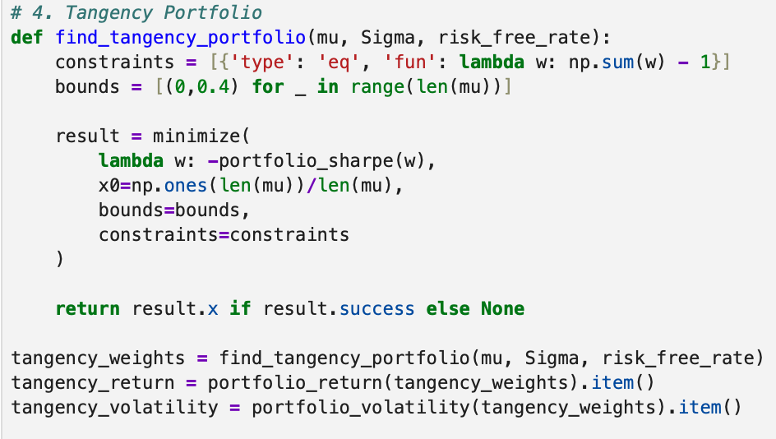
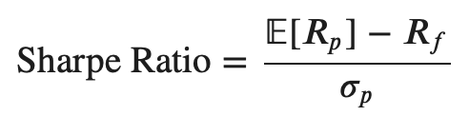
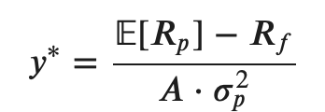
4.1 Tangency vs. Optimal complete portfolio
Tangency portfolio
On the efficient fronier/max. Sharp Ratio
Constraints (e.g. weights capped at 40%)
Optimal complete portfolio
Combines TP with risk-free-asset
Depends on the individual risk aversion

Slide 9
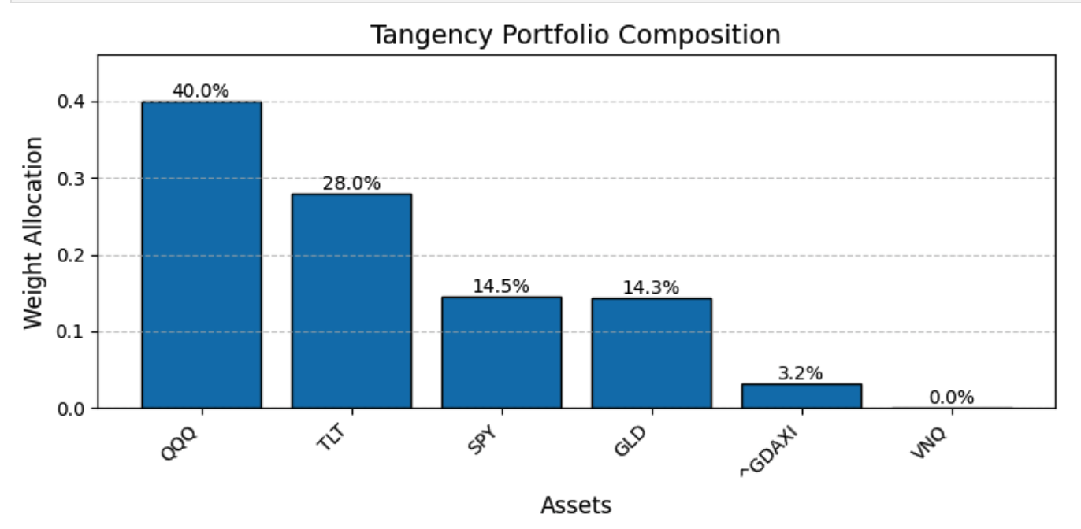
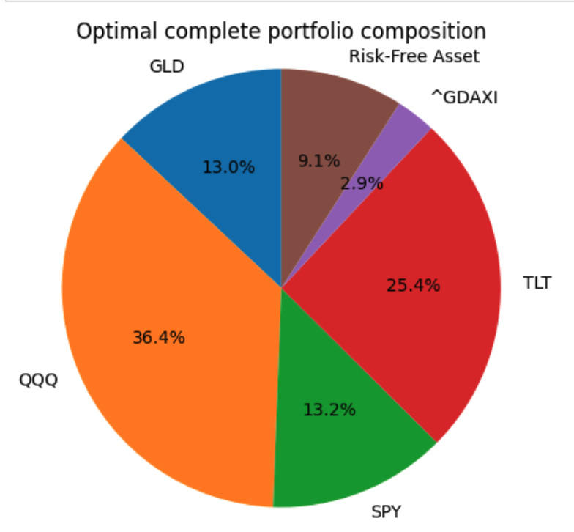
4.2 Portfolio Results
TP (exp.): ret: 12.21% p.a. / vol: 11.17% p.a.
Sharpe Ratio: 0.91
Nasdaq delivers high returns and is capped
Bonds are countercyclical and less volatile
Gold is a non-correlated diversifier
REITs and DAX have bad risk-return profiles
OCP (Risk Aversion = 9)
Personalized mix of return and risk along the CAL
Allocation: 9.1% risk-free / 90.9% risky assets

Slide 10
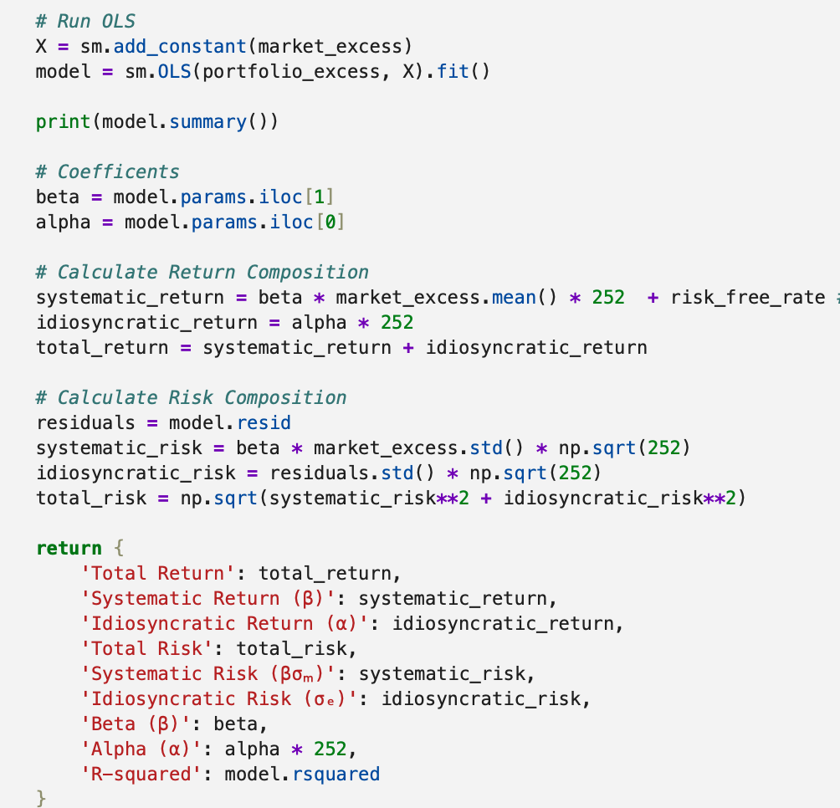
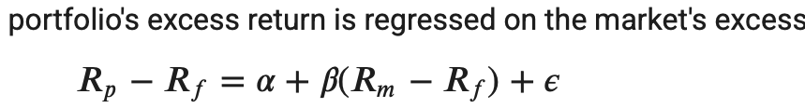

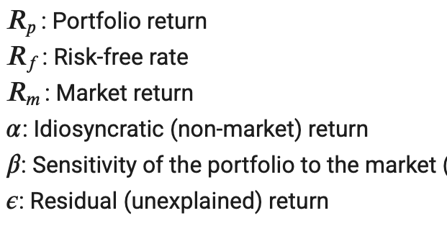
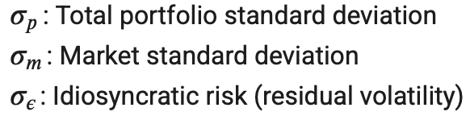
5.1 Risk Decomposition
Systematic component: explained by the market
Idiosyncratic component: firm-specific risk/return

Slide 11
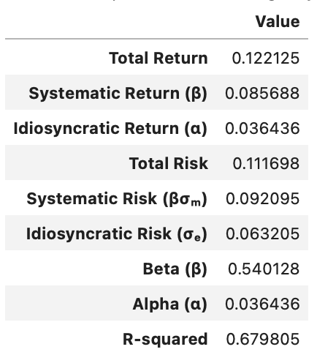
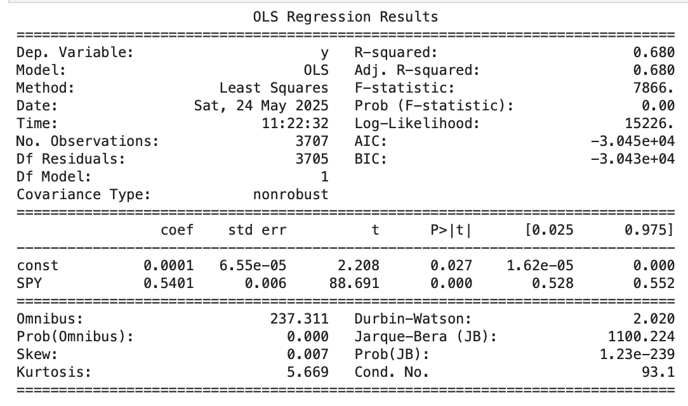
5.2 Risk/Return Decomposition
Beta = 0.54 → portfolio reacts moderately to market movements
Alpha = 0.036 → positive idiosyncratic return
R-squared = 0.68 → 68% the portfolio‘s variance is market-explained
Portfolio shows moderate exposure to market-risk
Delivers additional managable idiosyncratic risk
Total risk quite good given a total return of 12.21% p.a.
OLS-Output → Estimators are significant (p<0.05)

Slide 12
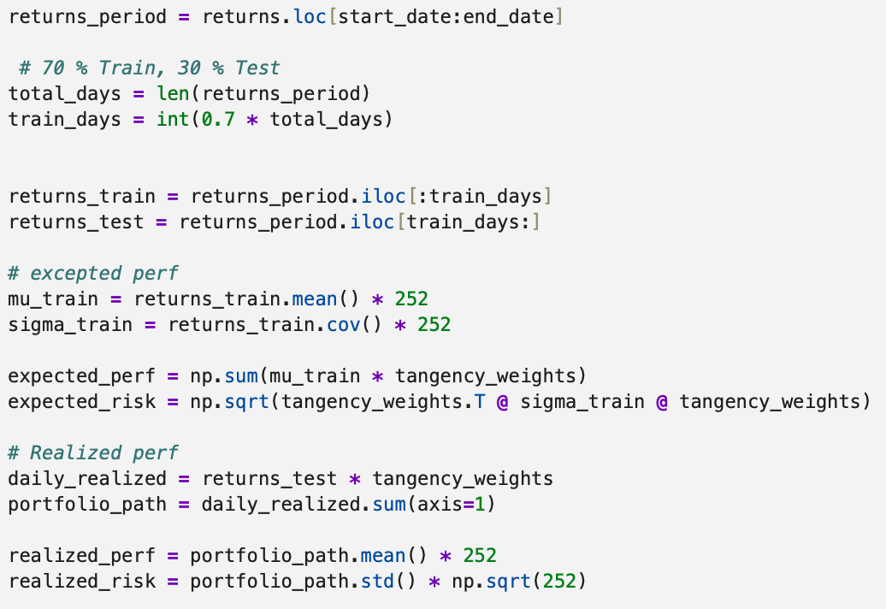
6.1 Expected vs. Realized Perfomance
Expected perf/vol: training sample 70%
Realized perf/vol: test sample 30%
return lower and vol higher than expected
Conclusion:
Future outcomes are uncertain
Changing market conditions, overfitting, estimation errors make predictions hard
But still robust and well composed porfolio

